Slide 1
Linking OneNote Pages OneNote Tags
10/10/2017

Slide 2
How to create links to SECTIONS
Right-click the tab of the section that the link should point to.
On the shortcut menu, click Copy Link to Section.
The link to the selected section and the title of the section are copied to the Clipboard.
Click the location on the page that is to contain the link.
On the Edit menu, click Paste.
OneNote inserts a link that, when clicked, displays the target section.

Slide 3
How to create links to PAGES
In the side margin, right-click the tab of the page that the link should point to.
On the shortcut menu, click Copy Link to Page.
The link to the selected page and the title of the page are copied to the Clipboard.
Click the location on the page that is to contain the link.
On the Edit menu, click Paste.
OneNote inserts a link that, when clicked, displays the target page.

Slide 4
How to create links to PARAGRAPHS
Move your cursor to the left edge of the paragraph you want to link.
Right-click the four-headed arrow next to the paragraph the link should point to.
On the shortcut menu, click Copy Link to Paragraph.
The link to the selected paragraph and the paragraph text are copied to the Clipboard.
Click the location on the page that is to contain the link.
On the Edit menu, click Paste.
OneNote inserts a link that, when clicked, displays the target paragraph.

Slide 5
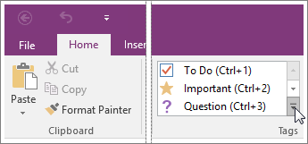
How to create TAGS
Place the cursor at the beginning of the line of text you want to tag.
Click Home > Tags, and then click the icon of the tag you want to apply.
Use the arrows next to the tags list to scroll through the available tags or click the More arrow in the lower-right corner of the scroll box to show all available tags.
You can search for tagged notes by keyword and category and see the results in an easy-to-read summary.

Slide 6
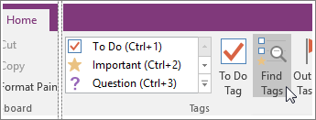
How to SEARCH for tags
If you’ve previously added tags to any of your notes, you can search for the tags by using tag keywords. In OneNote 2016, the results appear in an easy-to-read summary.
Note tags need to be associated with typed or handwritten notes in order for them to appear in your search.
Click Home > Find Tags

Slide 7
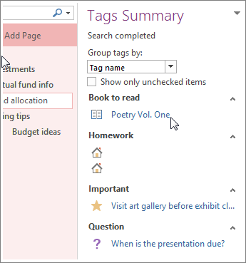
How to SEARCH for tags
In the Tags Summary task pane that opens, click any tag in the list to open the page that contains the associated tagged note.
If you want to view the tag search results as a notes page, click the Create Summary Page button at the bottom of the Tags Summary task pane.

Slide 8
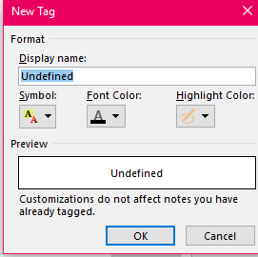
How to create CUSTOMIZED tags
Place the cursor at the beginning of the line of text you want to tag.
Click Home > Tags, and then click CUSTOMIZE TAGS located at the bottom
Click NEW TAG or MODIFY TAG
If CREATING a new tag – give the tag a name, choose a symbol for the tag, and select font color/highlight color is desired; click OK
If MODYIFING a tag – select the tag from list; click MODIFY TAG; change the name of the tag, change the symbol if needed, and change font color/highlight color if desired; click OK

Slide 9
How to REMOVE tags
You can remove tags from notes when they are no longer necessary. Removing note tags is useful if you frequently search by tagged notes and only want to see notes with tags that are current.
Do one of the following:
To remove a single note tag, right-click it on the page, and then click Remove Tag on the shortcut menu.
To remove multiple note tags, place the cursor anywhere in the text containing the tags that you want to remove, and then press CTRL+0 (ZERO).

Slide 10
OneNote Housekeeping
Click on your Class Notebook tab
Is there an update to install?
If YES, click the download and close OneNote
Run the update

